Slide 1
Week 13: Markov Chains
Goals:
Perform basic calculations by hand with transition matrices
Use R to find n-step transition matrices
Use Python to simulate a Markov chain

Slide 2

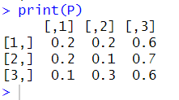
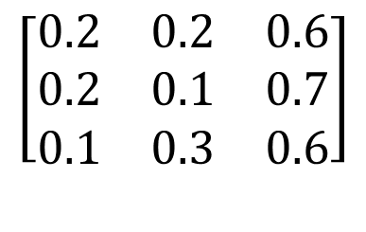
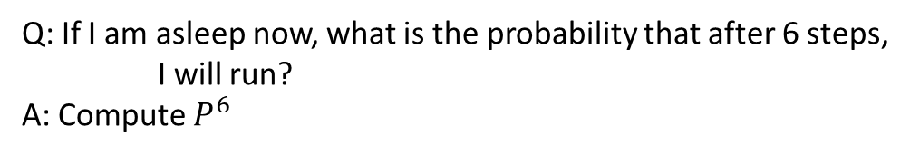
Markov chains
Hopefully we have spend some time working with Markov processes….
Ex: I have a 3-state Markov chain with state space {Sleep, Icecream, Run} and the given transition matrix. Find the
$n$- step transition matrix using R
Need to compute $P^{n}$!
Sleep Ice Cream Run
Q: If I am asleep now, what is the probability that after 6 steps,
I will run?
A: Compute $P^{6}$
Sleep
Ice Cream
Run
$$\left[\begin{matrix}0.2 & 0.2 & 0.6 \\ 0.2 & 0.1 & 0.7 \\ 0.1 & 0.3 & 0.6\end{matrix}\right]$$
Q: How to implement in R?
A: Carefully
Matrices in R:
# Enter the matrix as an ordered list
# To make a matrix, tell it number of rows and columns
# R defaults to filling columns first, so tell it “byrow=TRUE”
to make it fill out rows first
End of slide

Slide 3
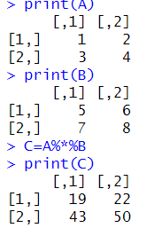
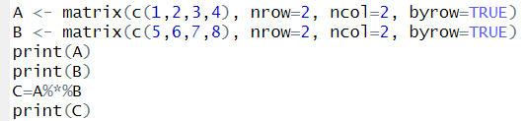
Markov chains
Matrices in R:
Hopefully we have spend some time working with Markov processes….
# Enter the matrix as an ordered list
# To make a matrix, tell it number of rows and columns
# R defaults to filling columns first, so tell it “byrow=TRUE”
to make it fill out rows first
Matrix multiplication in R: # %*% is the operator
Note: Matrix multiplication
is NOT term-by-term
End of slide

Slide 4

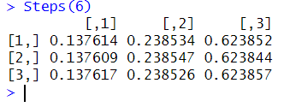
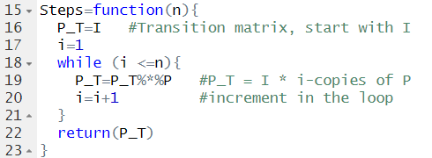
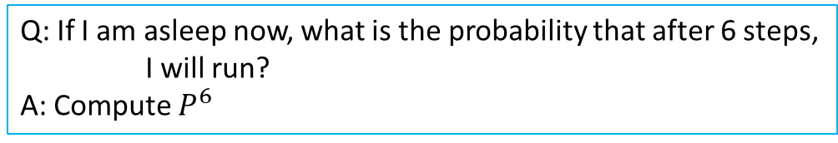
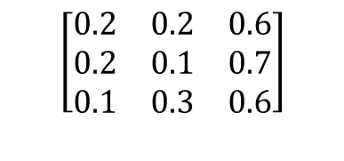
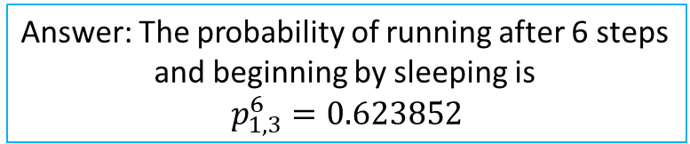

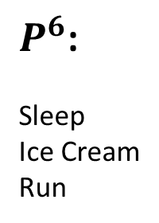
Markov chains
Sleep Ice Cream Run
Q: If I am asleep now, what is the probability that after 6 steps,
I will run?
A: Compute $P^{6}$
Sleep
Ice Cream
Run
$$\left[\begin{matrix}0.2 & 0.2 & 0.6 \\ 0.2 & 0.1 & 0.7 \\ 0.1 & 0.3 & 0.6\end{matrix}\right]$$
Matrices in R:
Identity Matrix:
$P^{6}$:
Sleep
Ice Cream
Run
Sleep Ice Cream Run
Make a function to compute $P^{n}:$
Answer: The probability of running after 6 steps
and beginning by sleeping is
$$p_{1,3}^{6}=0.623852$$
End of slide

Slide 5
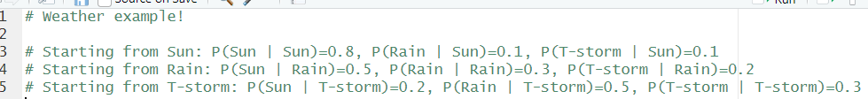
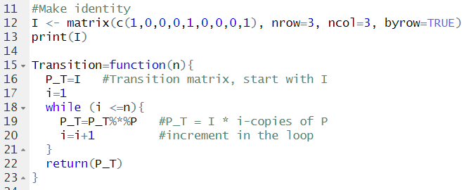

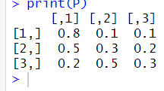
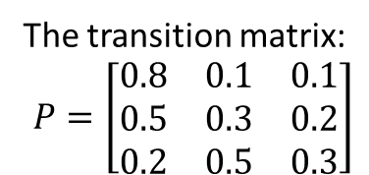
Markov chains
Ex: Suppose the state of the weather forms a Markov chain, with three states (Sun, Rain, and T-storms),
and you are the given transition probabilities.
Create the transition matrix in R,
Find the probability that if it is Raining today, it will T-storm in 4 days.
Find the probability that if it is Sunny today, it is NOT sunny in 3 days.
The transition matrix:
$$P=\left[\begin{matrix}0.8 & 0.1 & 0.1 \\ 0.5 & 0.3 & 0.2 \\ 0.2 & 0.5 & 0.3\end{matrix}\right]$$
The function:
End of slide

Slide 6
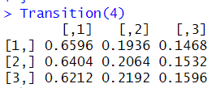
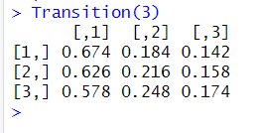
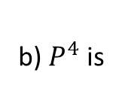


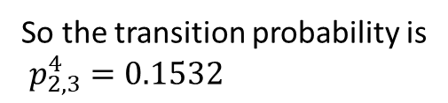
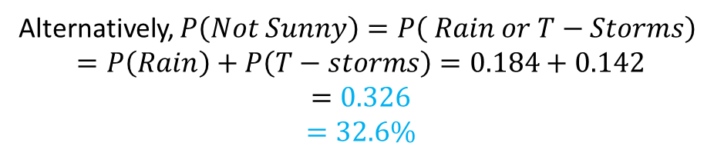
Markov chains
Ex: Suppose the state of the weather forms a Markov chain, with three states (Sun, Rain, and T-storms),
and you are the given transition probabilities.
Create the transition matrix in R,
Find the probability that if it is Raining today, it will T-storm in 4 days.
Find the probability that if it is Sunny today, it is NOT sunny in 3 days.
b) $P^{4}$ is
So the transition probability is
$p_{2,3}^{4}=0.1532$
Answer: b) $15.32\%$
c) $P^{3}$ is
So, $P\left(Not Sunny\right)=1−P\left(Sunny\right)=1−0.674=0.326=32.6\%$
Alternatively, $P\left(Not Sunny\right)=P\left( Rain or T−Storms\right)$
$$=P\left(Rain\right)+P\left(T−storms\right)=0.184+0.142$$
$$=0.326$$
$$=32.6\%$$
End of slide

Slide 7
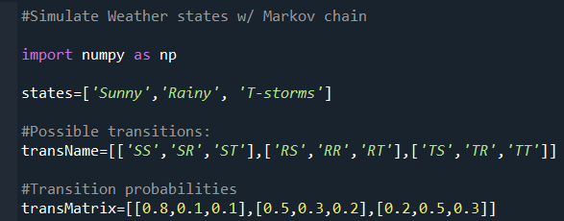
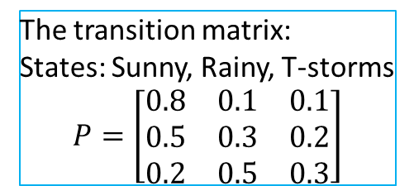
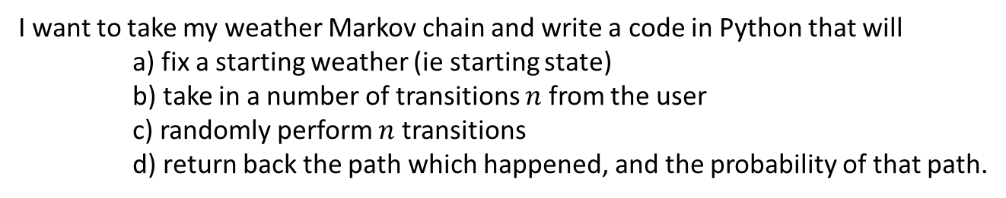
Markov chains
Ex: Coding a Markov chain simulation in Python
I want to take my weather Markov chain and write a code in Python that will
a) fix a starting weather (ie starting state)
b) take in a number of transitions $n$ from the user
c) randomly perform $n$ transitions
d) return back the path which happened, and the probability of that path.
The transition matrix:
States: Sunny, Rainy, T-storms
$$P=\left[\begin{matrix}0.8 & 0.1 & 0.1 \\ 0.5 & 0.3 & 0.2 \\ 0.2 & 0.5 & 0.3\end{matrix}\right]$$
End of slide

Slide 8
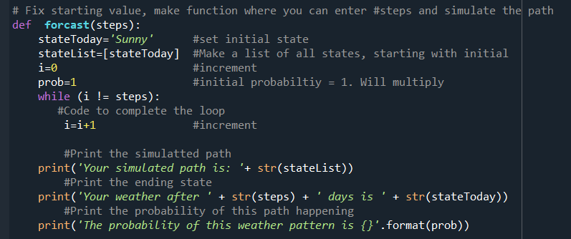

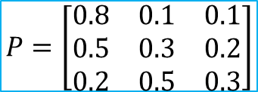
Markov chains
$$P=\left[\begin{matrix}0.8 & 0.1 & 0.1 \\ 0.5 & 0.3 & 0.2 \\ 0.2 & 0.5 & 0.3\end{matrix}\right]$$
Ex: Coding a Markov chain simulation in Python
Basic structure of the function:
In the while-loop, we need to make an if/elif environment for each possible transition
End of slide

Slide 9
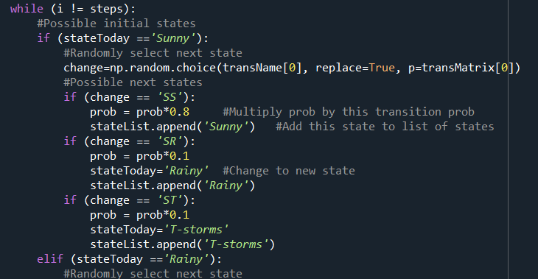
Markov chains
$$P=\left[\begin{matrix}0.8 & 0.1 & 0.1 \\ 0.5 & 0.3 & 0.2 \\ 0.2 & 0.5 & 0.3\end{matrix}\right]$$
Ex: Coding a Markov chain simulation in Python
The while loop: for when your starting state is “Sunny”
transName[0] and transMatrix[0]:
We are using the first vectors in these
lists because our transitions start at “S”
remember: lists start at 0
in Python.
At the bottom, the start of the next possible starting state.
Copy the same format for that state, but with changes “RS”, “RR”, and “RT
End of slide

Slide 10
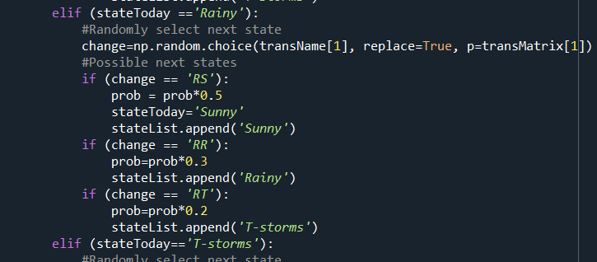
Markov chains
$$P=\left[\begin{matrix}0.8 & 0.1 & 0.1 \\ 0.5 & 0.3 & 0.2 \\ 0.2 & 0.5 & 0.3\end{matrix}\right]$$
Ex: Coding a Markov chain simulation in Python
The while loop: for when your starting state is “Rainy”
transName[1] and transMatrix[1]:
We are using the 2nd vectors in these
lists because our transitions start at “R”
remember: lists start at 0
in Python.
At the bottom, the start of the next possible starting state.
Copy the same format for that state, but with changes “RS”, “RR”, and “RT
End of slide

Slide 11
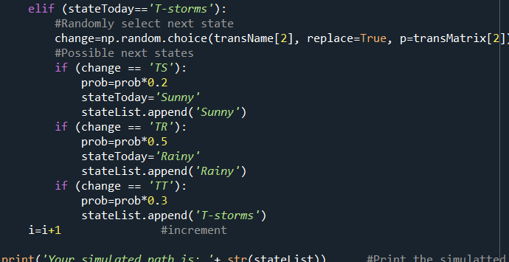
Markov chains
$$P=\left[\begin{matrix}0.8 & 0.1 & 0.1 \\ 0.5 & 0.3 & 0.2 \\ 0.2 & 0.5 & 0.3\end{matrix}\right]$$
Ex: Coding a Markov chain simulation in Python
The while loop: for when your starting state is “T-storms”
transName[2] and transMatrix[2]:
We are using the 3rd vectors in these
lists because our transitions start at “R”
remember: lists start at 0
in Python.
At the bottom, the start of the next possible starting state.
Copy the same format for that state, but with changes “RS”, “RR”, and “RT
End of slide

Slide 12




Markov chains
$$P=\left[\begin{matrix}0.8 & 0.1 & 0.1 \\ 0.5 & 0.3 & 0.2 \\ 0.2 & 0.5 & 0.3\end{matrix}\right]$$
Ex: Coding a Markov chain simulation in Python
Running my simulation:
End of slide

